Slide 1
Lead Scoring Case Study
Anand Prakash
Dhruv Ajmeri
Rahul Gupta

Slide 2
TABLE OF CONTENT
Lead Scoring Case Study
Read and understand the data
Data Cleaning and Preparation
Dummy variable creation
Test-Train Split
Feature Scaling
Correlations
Prepare the data for modelling
Model Building
Model Evaluation
Finding the Optimal Cutoff
Making Predictions on the Test Set
Precision-Recall View
Precision and recall tradeoff
Making Predictions on the Test Set
Summary

Slide 3
Lead Scoring Case
An education company named X Education sells online courses to industry professionals. On any given day, many professionals who are interested in the courses land on their website and browse for courses. The company markets its courses on several websites and search engines like Google. Once these people land on the website, they might browse the courses or fill up a form for the course or watch some videos. When these people fill up a form providing their email address or phone number, they are classified to be a lead. Moreover, the company also gets leads through past referrals. Once these leads are acquired, employees from the sales team start making calls, writing emails, etc. Through this process, some of the leads get converted while most do not. The typical lead conversion rate at X education is around 30%. There are a lot of leads generated in the initial stage (top) but only a few of them come out as paying customers from the bottom. In the middle stage, you need to nurture the potential leads well (i.e. educating the leads about the product, constantly communicating etc. ) in order to get a higher lead conversion. X Education has appointed you to help them select the most promising leads, i.e. the leads that are most likely to convert into paying customers. The company requires you to build a model wherein you need to assign a lead score to each of the leads such that the customers with higher lead score have a higher conversion chance and the customers with lower lead score have a lower conversion chance. The CEO, in particular, has given a ballpark of the target lead conversion rate to be around 80%.

Slide 4
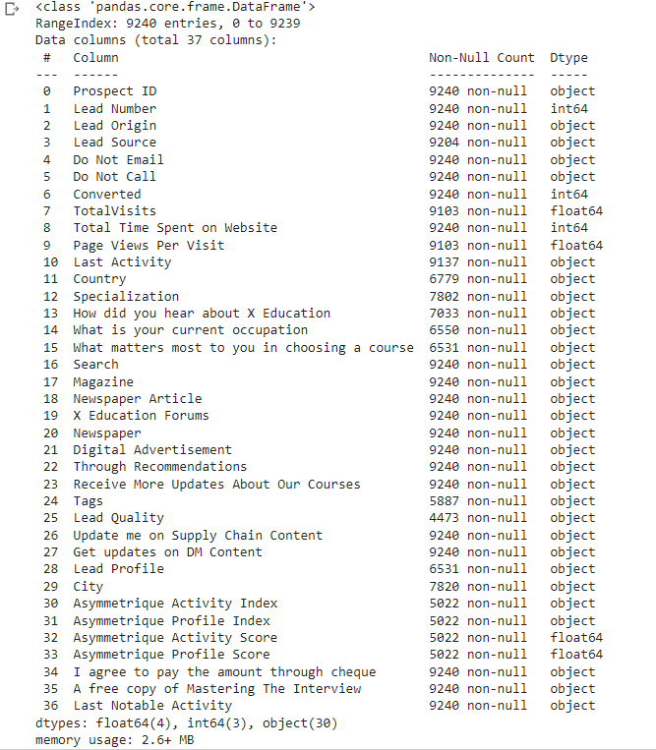
There are quite a few categorical variables present in this dataset for which we will need to create dummy variables. Also, there are a lot of null values present as well, so we will need to treat them accordingly.

Slide 5
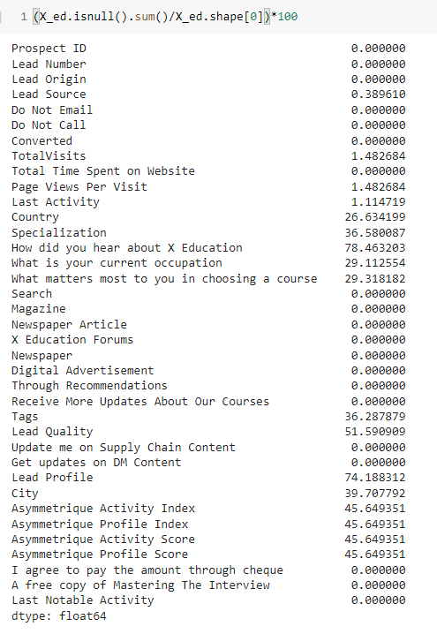
Handling the Missing Values in the Data
There are a few columns in which there is a level called 'Select' which basically means that the student had not selected the option for that particular column which is why it shows 'Select'. These values are as good as missing values and We need to convert all the 'select' to NaN
Dropping the features with more than 70% of missing data/ NaN values

Slide 6
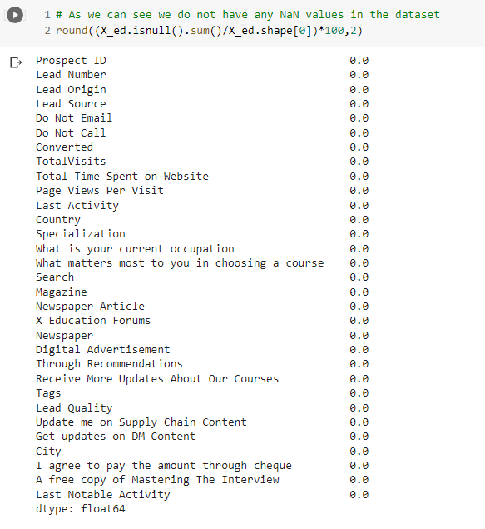
We can replace NaN values with 'India' as it is them most frequent in this feature
Replacing NaN values with ”Will revert after reading
the email” as it is the mode of the feature
Dropping the below columns as it has too much variations present in the data that makes it difficult to judge which values that can be imputed in place of NaN values
Asymmetrique Activity Index
Asymmetrique Activity Score
Asymmetrique Profile Index
Asymmetrique Profile Score

Slide 7
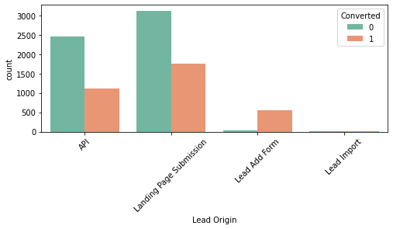
Analysis:
The leads from API and Landing Page Submission are very high but the conversion is about ~30%.
Lead add Form has very high conversion rate.
Lead Import has very less leads associated with it.
Inference:
In order to improve our overall lead conversion rate, we should focus on improving the conversion rate of leads coming from API and Landing Page Submission sources, and also generate more leads through the Lead Add Form.

Slide 8
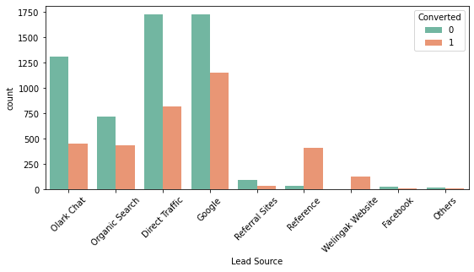
Analysis:
Google and Direct traffic are the main sources of leads.
Leads from reference sources and the welingak website have a high conversion rate
Inference:
In order to increase the overall lead conversion rate, we should work on improving the conversion rate of leads from olark chat, organic search, direct traffic, and google, and also generate more leads from reference sources and the welingak website

Slide 9
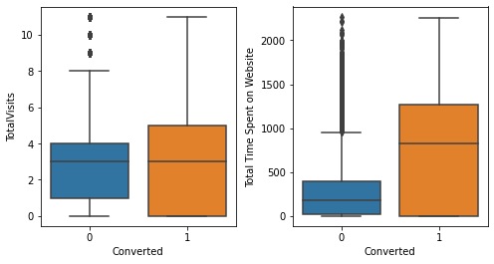
Analysis:
Since the median for both conversions and non-conversions is the same, nothing definitive can be inferred from this data.
More engaged visitors are more likely to convert on a website
Inference:
We can make more appealing websites in order to increase the time spent by Users on websites

Slide 10
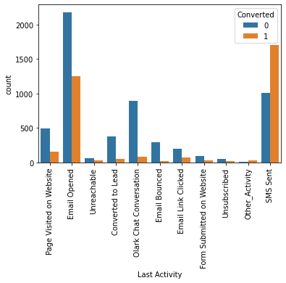
Analysis:
The most common last activity is "Email Opened"
The conversion rate is highest for SMS sent as the last activity.
Inference:
By calling those leads who had their last activity as an email opened, we should concentrate on boosting their conversion rate. We should also work to raise the number of leads who had their last activity as an SMS sent.

Slide 11
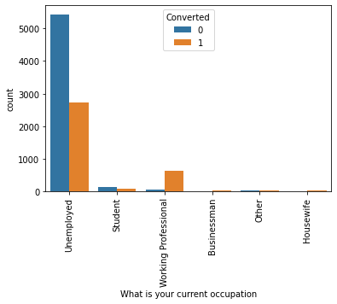
Analysis:
No specific conclusions regarding specialization can be drawn from the plot shown above.
Working professionals have a high conversion rate, as seen in the above plot.
More leads come from the unemployed category than any other.
Inference:
To improve the overall conversion rate, we should aim to increase the number of Working Professional leads by using social sites like LinkedIn to reach out to them, and also work on improving the conversion rate of Unemployed leads
The Country, What matters most to you in choosing a course, and City columns have many values that correspond to one value, such as India for Country and Mumbai for City, so there are no specific insights that can be drawn from these columns

Slide 12
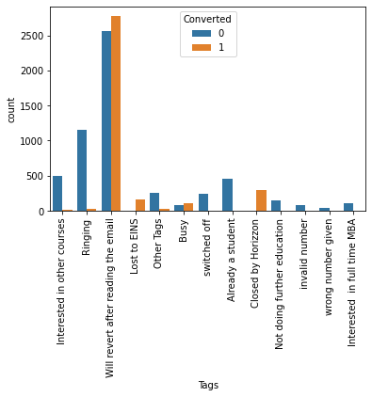
ANALYSIS:
High conversion rates for "Will revert after reading the email" and "Closed by Horizzon"

Slide 13
SUMMARY:
In order to enhance the general lead conversion rate, we should concentrate on improving the conversion rate for leads from the 'API' and 'Landing Page Submission' sources, as well as increasing the number of leads generated from the 'Lead Add Form.
We need to concentrate on boosting the conversion rates of "Google," "Olark Chat," "Organic Search," and "Direct Traffic," as well as increasing the number of leads from "Reference" and "Welingak Website" in order to increase the overall lead conversion rate.
Websites can be improved to attract more users and lengthen their visits
We should focus on increasing the conversion rate of those having last activity as Email Opened by making a call to those leads and also try to increase the count of the ones having last activity as SMS sent
By connecting with them on various social networks, like LinkedIn and others, we can raise the number of working professional leads. We should also focus on improving the conversion rate of unemployed leads in order to increase overall conversion rates.
We've noted that several columns only included data with a single value. These columns can be excluded from further analysis because they don't support any inferences.

Slide 14
Dummy variable creation
So now we have to create the dummy variables for the following, and we can drop the features after, as they are not required for the model building.
Lead Origin
Lead Source
Last Activity
Specialization
What is your current occupation
Tags
Lead Quality
City
Last Notable Activity

Slide 15
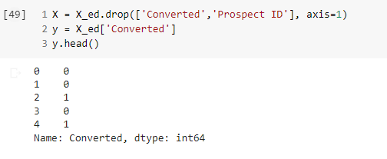
Test-Train Split
The next step is to split the dataset into training an testing sets.
Performing train test split operation - 70% training data and 30% test data.
X_train, X_test, y_train, y_test = train_test_split(X, y, train_size=0.7, test_size=0.3, random_state=100)

Slide 16
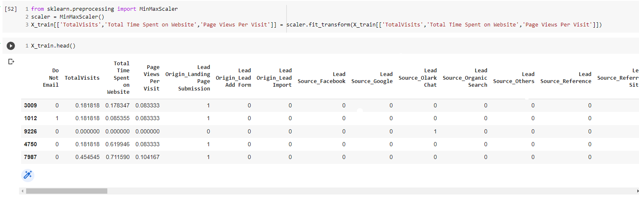
Feature Scaling
Using Standard Scaler to perform scaling due to some numeric variable have different scales

Slide 17
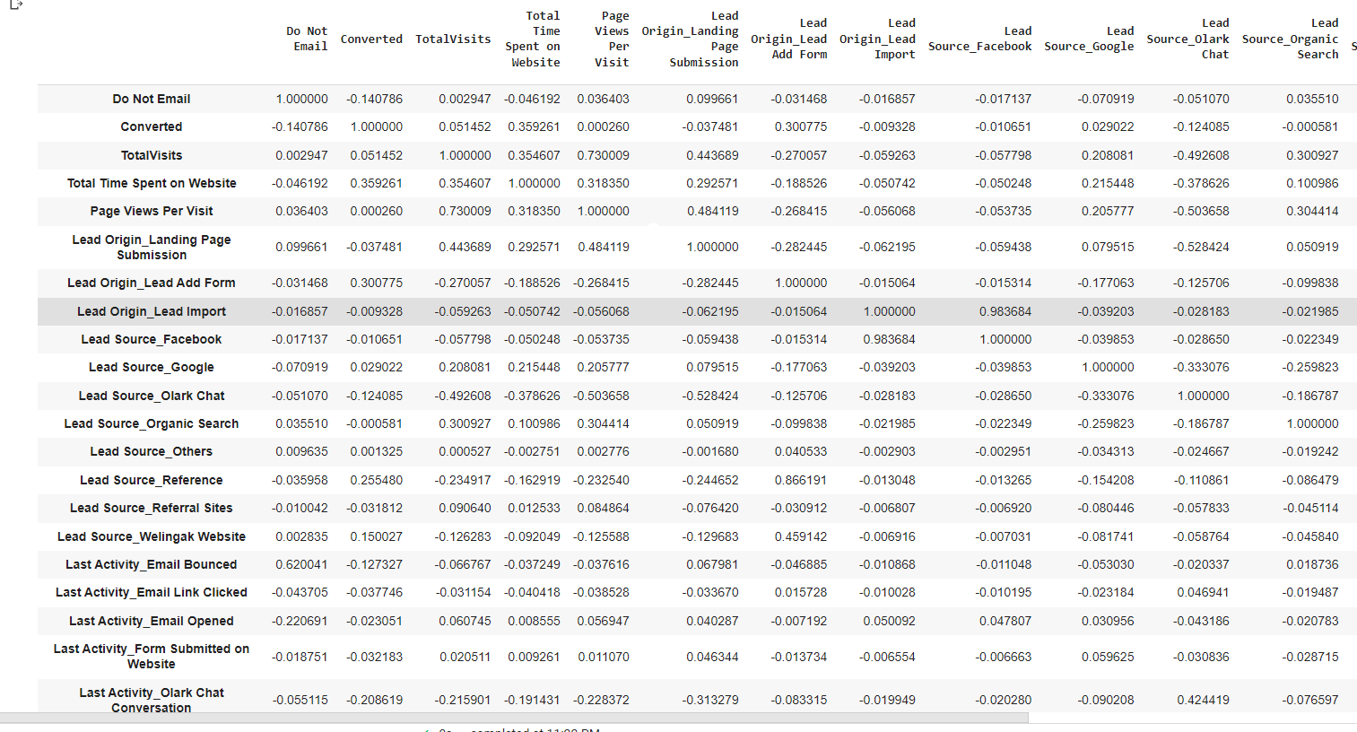
Let's now look at the correlations. Since the number of variables are pretty high, it's better that we look at the table instead of plotting a heatmap

Slide 18
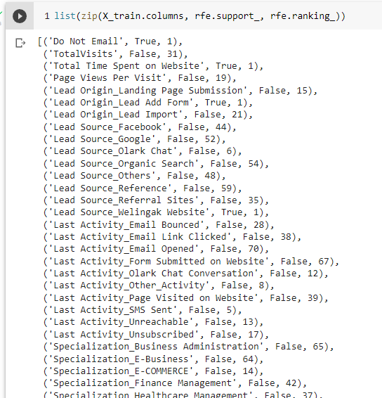
Model Building
Let's now move to model building. As you can see that there are a lot of variables present in the dataset which we cannot deal with. So the best way to approach this is to select a small set of features from this pool of variables using RFE.
On the right are some of features which have been selected by RFE

Slide 19
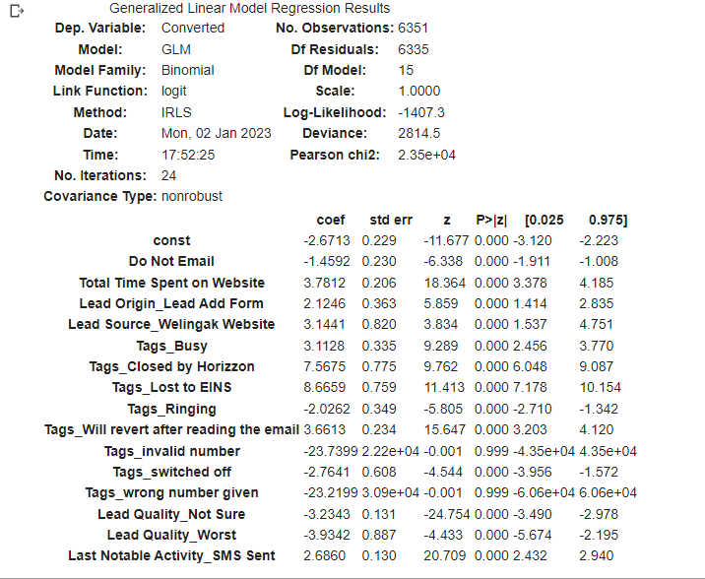
Assessing the model with Stats Models
We can see some variable having p-value grater than 0.05, [Tags_invalid number and Tags_wrong given number]

Slide 20
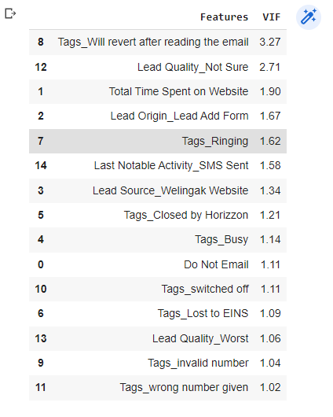
We will check VIF first ,
So, we have all variable with VIF < 5, so now we will remove those variable whose P-value is grater than 0.05.

Slide 21
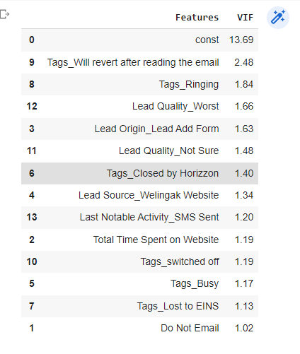
After dropping the following features with
p-values greater then 0.05.
Tags_invalid number
Tags_wrong number given
Tags_wrong number given
Tags_invalid number
All the p-values are now in the appropriate range. Check the VIFs again in case we had missed something.

Slide 22
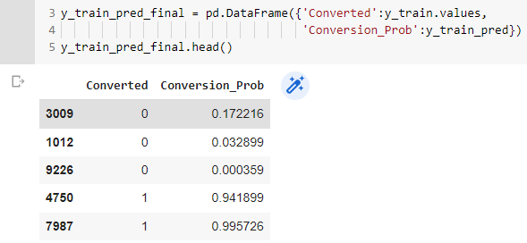
Model Evaluation
Creating a new data frame containing the actual conversion flag and the probabilities predicted by the model

Slide 23
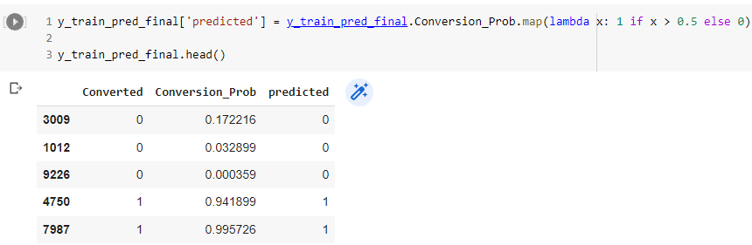
Creating new column 'Predicted' with 1 if Paid_Prob > 0.5 else 0

Slide 24
So, we have mapped probabilities now lets evaluate our model
Predicted | Not converted | converted
Actual
Not converted | 3702 | 203
converted | 299 | 2147
True positive (TP) = confusion[1,1]
True négatives (TN) = confusion[0,0]
false positives (FP) = confusion[0,1]
false négatives (FN) = confusion[1,0]
Overall accuracy | Sensitivity(TP/(TP+FN)) | Specificity(TN/(TN+FP))
0.9209573295544009 | 0.8777596075224857 | 0.9480153649167734

Slide 25
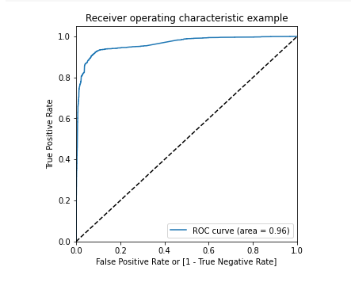
Finding the Optimal Cutoff
Now 0.5 was just arbitrary to loosely check the model performance. But in order to get good results, we need to optimize the threshold. So first let's plot an ROC curve to see what AUC we get.
The area under the curve of the ROC is 0.96 which is very good. So we seem to have a good model. Let's also check the sensitivity and specificity tradeoff to find the optimal cutoff point.

Slide 26
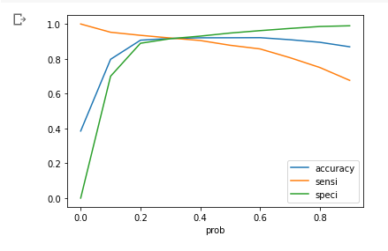
Let's create a Data frame to see the values of accuracy, sensitivity, and specificity at different values of probability cutoffs
As you can see that around 0.40 you get the optimal values of the three metrics. So let's choose 0.42 as our cutoff now.

Slide 27
Let's check the accuracy now
Predicted | Not converted | converted
Actual
Not converted | 3633 | 272
converted | 232 | 2214
True positive (TP) = confusion2[1,1]
True négatives (TN) = confusion2[0,0]
false positives (FP) = confusion2[0,1]
false négatives (FN) = confusion2[1,0]
Overall accuracy | Sensitivity(TP/(TP+FN)) | Specificity(TN/(TN+FP))
0.920642418516769 | 0.9051512673753066 | 0.9303457106274008
This cutoff point seems good to go!

Slide 28
Making Predictions on the Test Set
Predicted | Not converted | converted
Actual
Not converted | 1600 | 134
converted | 117 | 872
True positive (TP) = confusion[1,1]
True négatives (TN) = confusion[0,0]
false positives (FP) = confusion[0,1]
false négatives (FN) = confusion[1,0]
Overall accuracy | Sensitivity(TP/(TP+FN)) | Specificity(TN/(TN+FP))
0.9078222548659567 | 0.8816986855409504 | 0.922722029988466

Slide 29
Precision-Recall View
Building training model using precision recall view
Predicted | Not converted | converted
Actual
Not converted | 3702 | 203
converted | 299 | 2147
Précision [confusion[1,1]/(confusion[0,1]+confusion[1,1])] | Recall [confusion[1,1]/(confusion[1,0]+confusion[1,1])]
0.9136170212765957 | 0.8777596075224857

Slide 30
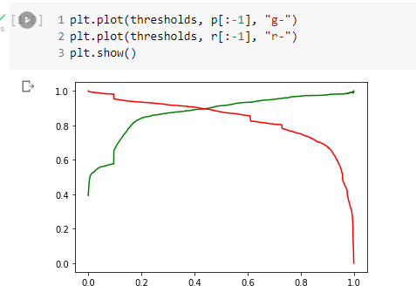
Evaluate Precision recall tradeoff

Slide 31
Make prediction on test data
Predicted | Not converted | converted
Actual
Not converted | 1613 | 121
converted | 125 | 861
True positive (TP) = confusion[1,1]
True négatives (TN) = confusion[0,0]
false positives (FP) = confusion[0,1]
false négatives (FN) = confusion[1,0]
Overall accuracy | Precision(TP/(TP+FN)) | Recall(TN/(TN+FP))
0.9085567388909291 | 0.8767820773930753 | 0.8705763397371082

Slide 32
Summary
Aim was to find out which all variables are directly impacting the conversion rate, so after performing data cleaning on original data we selected only few variables – i. Many leads are generated from landing page submission, which was through organic search, direct traffic or through google. ii. Very less time is spent on website, may be due to its UI/UX, as conversion is higher if person spends most of its time o website. iii. Email opening is the activity which is performed the most when online. Also, very apt segment is spending time on websites – mostly un employed
Now after, EDA we divided data to train and testing set – mapped correlation shows high number of features were collinear with each other (multi-collinearity issue).
We used RFE , VIF and P-value check for elimination/selection of appropriate features- i. Tags_Will revert after reading the email ii. Lead Quality_Not Sure iii. Total Time Spent on Website iv. Lead Origin_Lead Add Form v. Tags_Ringing vi. Last Notable Activity_SMS Sent vii. Lead Source_Welingak Website viii. Tags_Closed by Horizzon ix. Tags_Busy x. Do Not Email xi. Tags_switched off xii. Tags_Lost to EINS xiii. Lead Quality_Worst
Then we predicted, and evaluated the model on predicted variables by checking stats metrics by performing confusion metrics - i. After selecting apt features through VIF/P-value check a. Accuracy – 92% b. Sensitivity – 87.7% c. Specificity – 94.8% ii. Are under ROC curve is 96% , which shows good model fit, to evaluate cut-off point we will check metrics – a. Accuracy – 92% b. Sensitivity – 90.5% c. Specificity – 93.5%
We also made prediction on the test set using the same variable used after VIF/p-value check – i. Fitting the learnt model on test data below are metrics numbers – a. Accuracy – 90.7% b. Sensitivity – 88.1% c. Specificity – 92.27% ii. We also check precision and recall on the data – a. Accuracy – 90.85% b. Sensitivity – 87.67% c. Specificity – 87.05% So, looking at the metrics we can say that all the variables are mostly correctly predicted whether they are converted or not. Also the lead score mapped were highest for the above mentioned feature variables which indicates that the above variables are very helpful in determining whether the Lead will get ‘Converted’ or ‘Not converted’.

